Slide 1
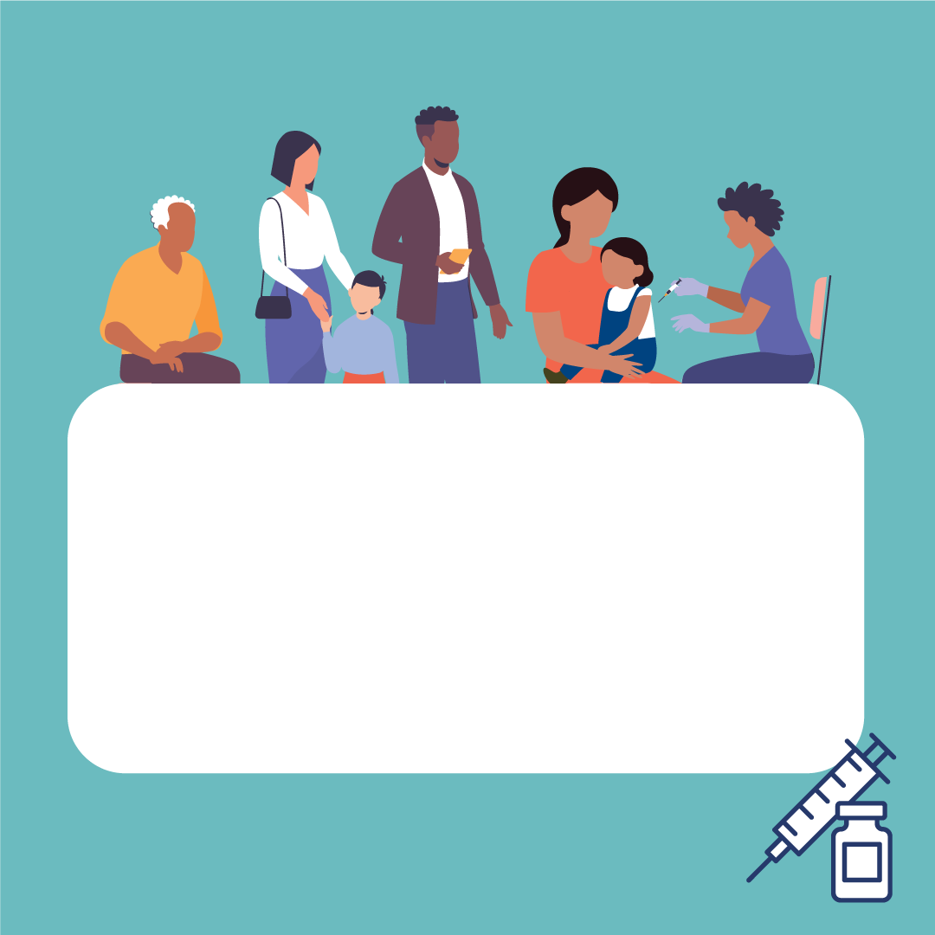

Vaccines protect everyone: children, adolescents, adults and the elderly. Protect yourself, your family and your community by being up-to-date with your vaccines. #VaccinesWork #UnitedInProtection #EIW2023

Slide 2

For over 200 years, vaccines have been saving millions of lives across the globe. They have eradicated smallpox and allowed deadly diseases like polio to be controlled. That’s the result of science and research. #VaccinesWork #UnitedInProtection #EIW2023

Slide 3
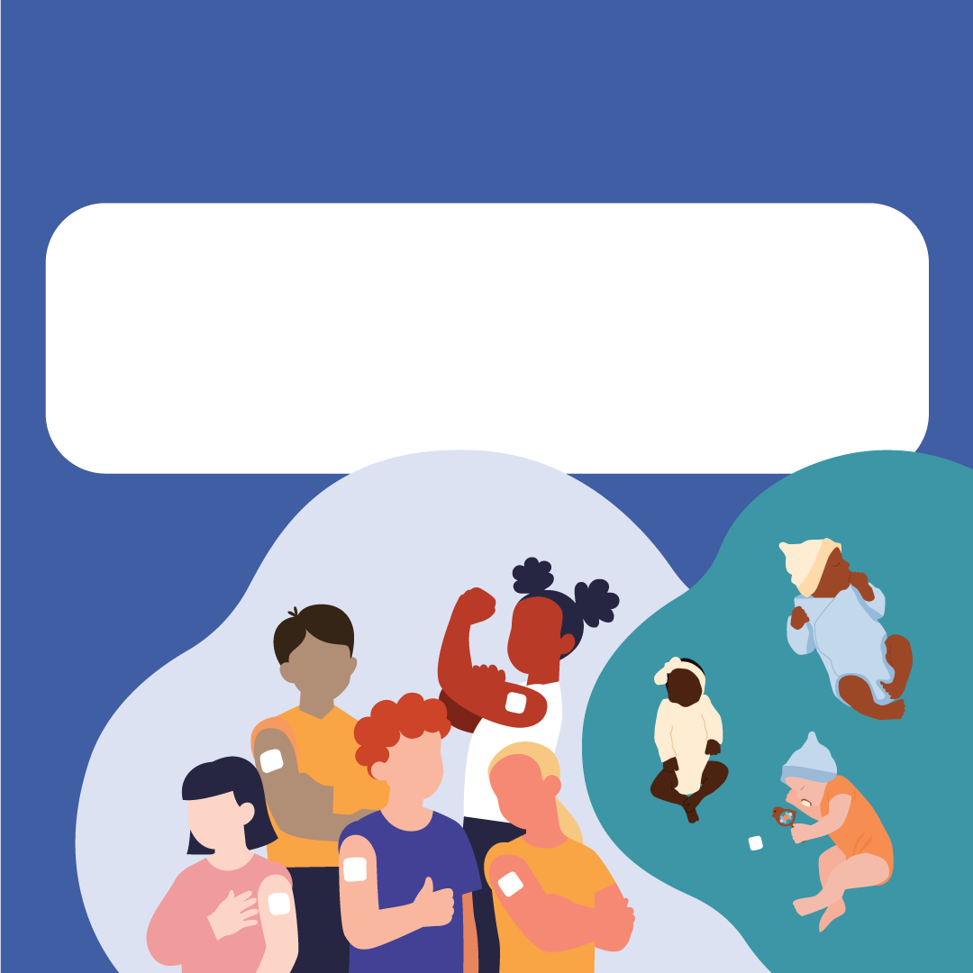
Offer your child a safe start in life! Protect your child from vaccine-preventable diseases! #VaccinesWork #UnitedInProtection #EIW2023

Slide 4

Did your child miss a vaccine dose? Talk to your healthcare professional and get your child vaccinated as soon as possible to complete the recommended vaccination course! #VaccinesWork #UnitedInProtection #EIW2023

Slide 5
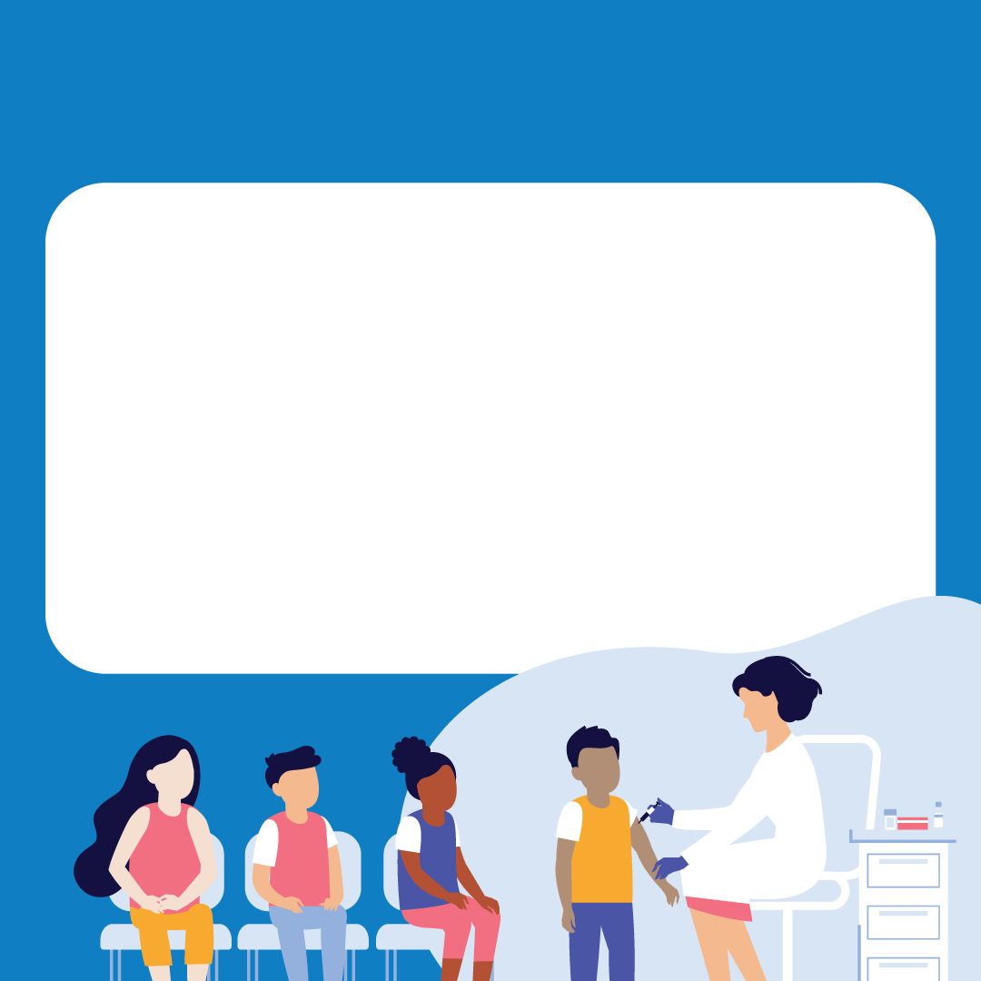
Vaccination of girls and boys against HPV can prevent later infections with HVP, the most common sexually transmitted infection. HPV can lead to cancer in both men and women. Get informed, get screened, get vaccinated! #VaccinesWork #UnitedInProtection #EIW2023

Slide 6

Vaccines are not only for children. Check the recommended vaccines in your country! Many countries recommend booster vaccines for diseases such as diphtheria or tetanus during adulthood. Check the recommended vaccines in your country and discuss with your doctor! Vaccines save lives. #VaccinesWork #UnitedInProtection #EIW2023

Slide 7
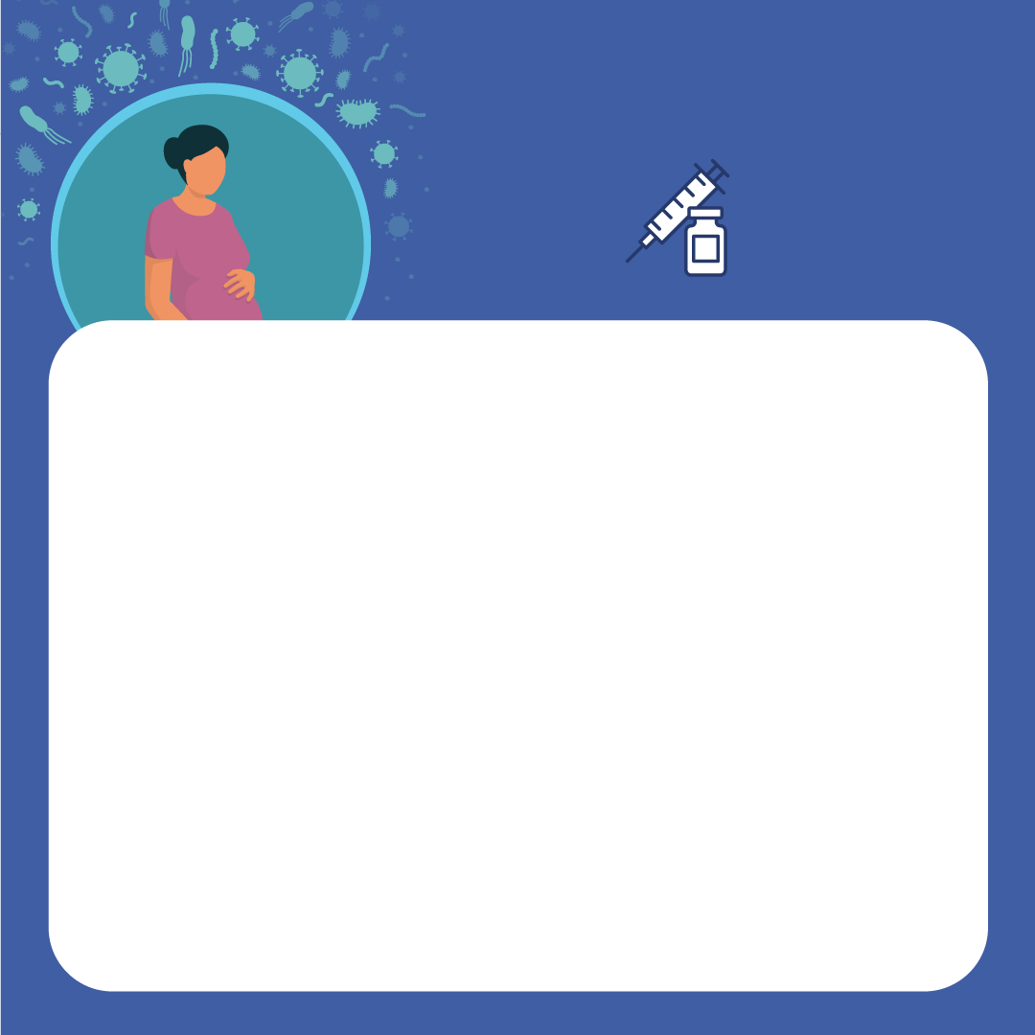
Unvaccinated women who get rubella early during pregnancy are at increased risk of miscarriage and their babies can be born with congenital rubella syndrome. Protect yourself and your baby, discuss with your doctor to ensure you are up-to-date on recommended vaccines well before pregnancy! Vaccines save lives. #VaccinesWork #UnitedInProtection #EIW2023

Slide 8

People of all ages can get COVID-19 or influenza, but older individuals can develop more often serious symptoms that may require hospitalisation or even endanger their lives. Follow national recommendations and stay up-to-date on vaccinations! Vaccines save lives. #VaccinesWork #UnitedInProtection #EIW2023

Slide 9
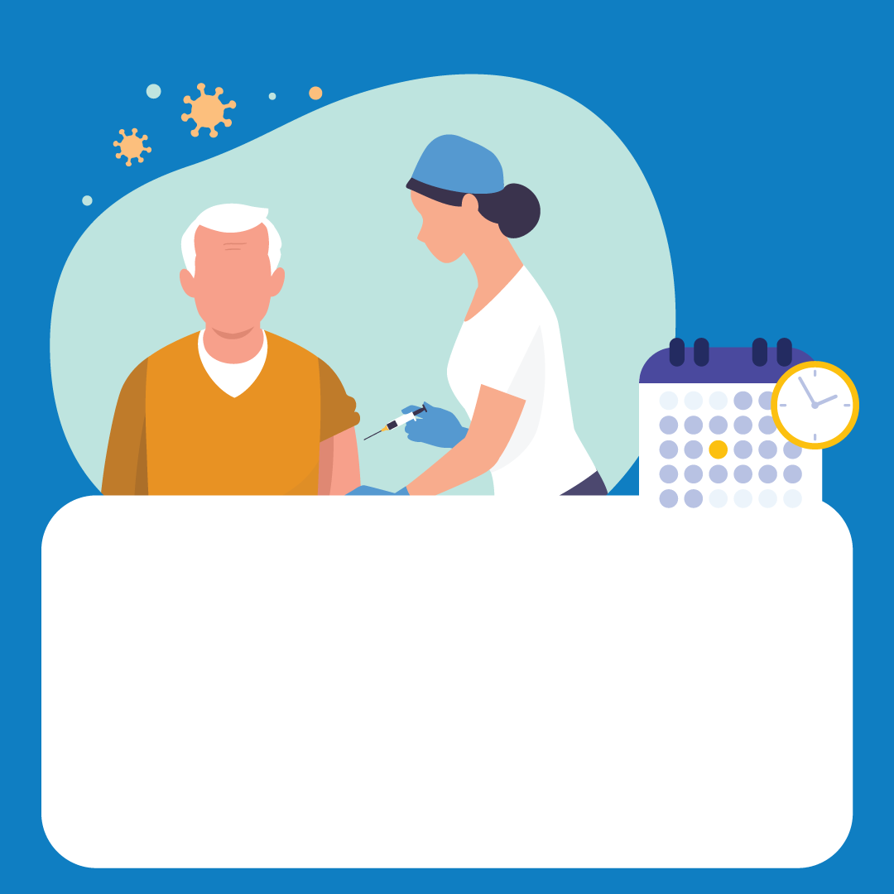
With age, comes wisdom! Be wise, talk to your doctor and check the national recommendations for vaccines for your age. Make informed decisions! #VaccinesWork #UnitedInProtection #EIW2023

